Slide 1
Machine Learning Random Forest
Basic concepts
Leticia Santos
Dr. Thanos Gentimis
EXST 7087

Slide 2
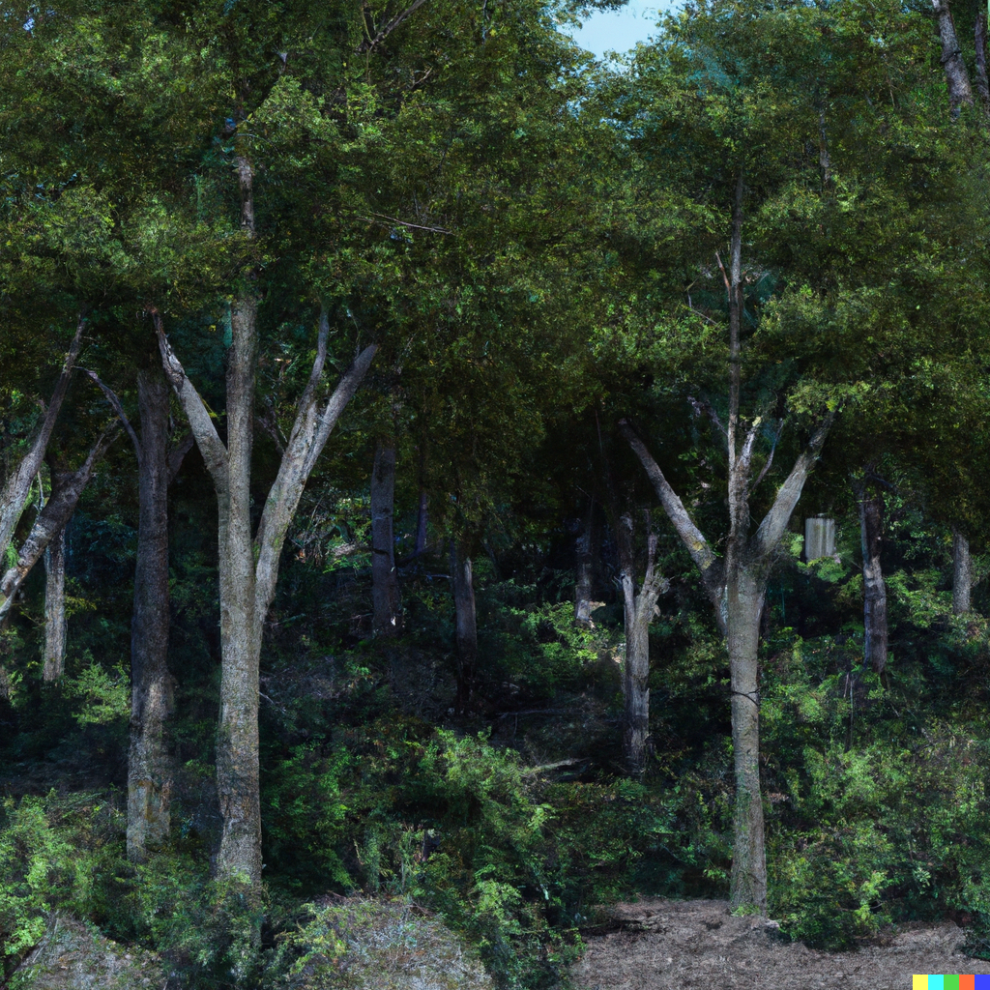
What’s a Random Forest?
The Random Forest algorithm was developed by Computer Scientist Tin Kam Ho in 1995. Although, many improvements have been made since.
Breiman, 2001 - Statistics Department, University of California
Random forest is a powerful ensemble-learning method: several of trees (forest)
Supervised
Notes:
Unsupervised learning (no categorization or labelling of the data)
Groups things together according to similarities, finding hidden structures and patterns

Slide 3
Examples
Loan eligibility
Object detection
Remote sensing – classification of data
Yield prediction
Prices in the stock market******
Diagnose patients
E-commerce (consumption behavior)

Slide 4
Concepts
Ensemble method that combines multiples decisions trees and average to a final result
Classification: unweighted majority of class votes
Regression: average of the predictions from all the trees in the forest
Weighted average (advanced)
Notes:
Trees/classifiers that perform best on the hard-to-classify instances receive the strongest weight.
RF classifier tends to be biased towards the majority class, weights can be assigned to each class in order to deal with the issue of imbalance.
Rather than considering a random subset of predictors at each node, RFW considers all variables with those with higher weights being more likely to be used in tree construction.

Slide 5
Concepts
Each tree is built on a different subset (this will add randomness to the model)
Randomness is important to avoid overfitting (learning wrong outcomes)
The randomness comes from the feature selection and the bootstrapping
Notes:
Make it two slides

Slide 6
What is a tree?
Series of if-then statements about the independent variables in a certain observation to predict a number (Regression).
Decision trees splits the dataset recursively using the decision nodes, until it’s a pure leaf node.
PROBLEM: small changes in the training data, might return a completely different result.
Sensitive to training data
High variance
Might fail to generalize

Slide 7

Each tree workflow
Subset rows - a bootstrap dataset
Subsets of variables – number of variables (max_features)
REPEAT – number of trees in the forest (n_estimators)
Go to the testing set
Keep track of the results of each tree, and the result is the majority voted.

Slide 8
Each tree workflow
GOAL: captures the regularities in its training data, but also generalizes well to unseen data
Regression Random Forest will output the mean of all Decision Tree predictions as a Classification Random Forest will output the majority classification of all Decision Trees

Slide 9
Random Forest (sklearn package)
Non-deterministic method (Random)
Where the random comes from? Random subset of the available data and a random subset of the features
Multiple arguments-options (18)
Hyperlink to python documentation
Notes:
Non-deterministic: even for the same input, can exhibit different behaviors on different runs, as opposed to a deterministic algorithm. Nondeterministic algorithms are often used when the problem solved by the algorithm inherently allows multiple outcomes (or when there is a single outcome with multiple paths by which the outcome may be discovered, each equally preferable). Crucially, every outcome the nondeterministic algorithm produces is valid, regardless of which choices the algorithm makes while running.
For example, a neural network trained to generate images may produce slightly different outputs each time it is given the same input, due to the randomness inherent in the training process.

Slide 10

Structure
Information Gain (Reduces the entropy)
Gini Index (lower values)
Root node: No parents. Each tree starts with its own root node. Attribute Selective Measure (AMS)
Leaf node: No children
Edges: relationship between nodes
Prunning: Removing a sub-node
Edges
Depth
Notes:
GINI index: smaller the better and Information gain. calculates the amount of probability of a specific feature that is classified incorrectly when selected randomly
The variable selected as the root node is the one that best separates the data into different classes or categories, based on the criterion used.

Slide 11
Entropy
Measurement of disorder
Measure of the randomness in the information being processed
The higher the entropy, the harder it is to draw any conclusions from that information.
Where to split the data. Entropy helps to check the homogeneity of the data. Entropy is calculated using the following formula:
Entropy = ∑ -pi log2 (pi)

Slide 12
Bootstraping
Select random samples of variables as the training dataset for model calibration
For each variable, the function determines model prediction error if the values of that variable are permuted across the out-of-bag observations

Slide 13
Dataset example
id | x1 | x2 | x3 | x4 | y
0 | 0.9 | 13.64 | 21.46 | 6.82 | 0
1 | -1.38 | 29.58 | 23.5 | 6.79 | 0
2 | 0.99 | 4.89 | 12.54 | 2.07 | 0
3 | -0.38 | 20.65 | 24.63 | 30.5 | 0
4 | 1.09 | 14.31 | 16.4 | 27 | 0
5 | 1.04 | 19.28 | 6.84 | 11.12 | 1
6 | 0.95 | 12.46 | 29.89 | 23.81 | 1
7 | 1.06 | 9.73 | 3.11 | 6.87 | 1
8 | 0.9 | 26.92 | 24.39 | 30.93 | 1
9 | 1.68 | 14.34 | 6.07 | 16.49 | 1

Slide 14
Dataset example
Random sampling with replacement
Bootstrapped dataset
id | x1 | x2 | x3 | x4 | y
0 | 0.9 | 13.64 | 21.46 | 6.82 | 0
1 | -1.38 | 29.58 | 23.5 | 6.79 | 0
2 | 0.99 | 4.89 | 12.54 | 2.07 | 0
3 | -0.38 | 20.65 | 24.63 | 30.5 | 0
4 | 1.09 | 14.31 | 16.4 | 27 | 0
5 | 1.04 | 19.28 | 6.84 | 11.12 | 1
6 | 0.95 | 12.46 | 29.89 | 23.81 | 1
7 | 1.06 | 9.73 | 3.11 | 6.87 | 1
8 | 0.9 | 26.92 | 24.39 | 30.93 | 1
9 | 1.68 | 14.34 | 6.07 | 16.49 | 1
id |  | id |  | id |  | id
0 |  | 3 |  | 5 |  | 9
0 |  | 8 |  | 0 |  | 6
2 |  | 3 |  | 3 |  | 3
0 |  | 2 |  | 2 |  | 5
4 |  | 4 |  | 7 |  | 9
5 |  | 3 |  | 3 |  | 0
4 |  | 4 |  | 7 |  | 4
4 |  | 1 |  | 6 |  | 1
8 |  | 7 |  | 8 |  | 8
9 |  | 9 |  | 7 |  | 7
Y- Should I practice exercises?
X1 – Age
X2 – Weight
X3 – Height
X4 – Cholesterol index
x1,x2
x3,x4
x1,x4
x2,x3

Slide 15
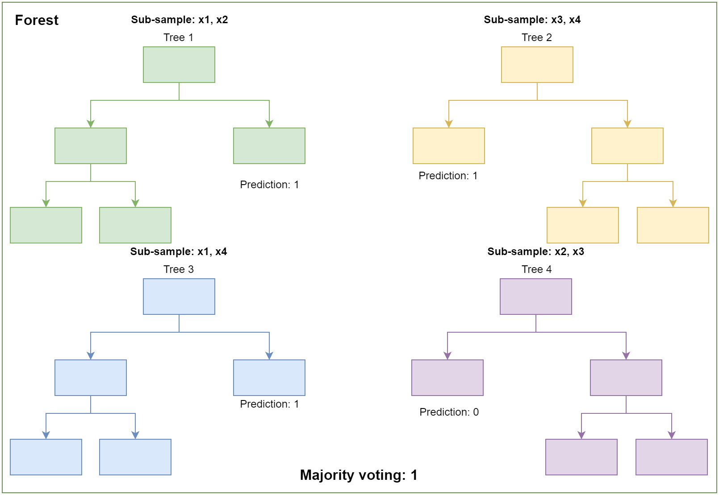
Use the new datapoints (testing) and keep the score
id
10
11
12
Combining results is called aggregation
Jargon: Bagging = aggregation + bootstrapping
Bootstrapping: every tree is built on a different subsample
Feature selection: reduces the correlation between the trees

Slide 16

Fine-tuning
Tuning ML hyperparameters is often considered to be an art which requires expert knowledge, rules-of-thumb, time, and significant computational resources

Slide 17
Hyper parameter tuning
Parameters:
max_depth : Longest path between the root node and the leaf node
n_estimators: Number of decision trees in the forest
max_features: Number of variables in each tree as a function of total variables
Most researchers are unaware!
Default settings, auto settings
Decision tree does not support categorical data as features, it has to be transformed into numerical (dummies variables)
Notes:
N_estimators: By using multiple decision trees, the random forest algorithm can reduce overfitting and improve the overall accuracy of the model.
Max_features: Searches for the best split by evaluating a subset of the available features. This is done to prevent the model from overfitting the training data by only using the most informative features. Lower value can reduce the variance of the model and prevent overfitting, while setting it to a higher value can increase the diversity of the trees in the forest and improve performance.
Depth - Tree depth refers to the number of levels or "branches" in a decision tree. A decision tree is a model that makes predictions by recursively splitting the data into smaller and smaller subsets based on the values of the input features, until a prediction can be made for each final subset.
The depth of a decision tree can have a significant impact on its performance and interpretability. A shallow tree with few levels may be easier to interpret and visualize, but may not capture all of the complexity in the data and may have lower accuracy. A deep tree with many levels may be able to capture more intricate patterns in the data, but may be more prone to overfitting and have poorer generalization performance on new data.

Slide 18
Bias-overfitting tradeoff
We want the training data to fit very closely to realty, but not that much because it can over-interpret outliers and predict wrong outcomes
But don’t ignore too much, otherwise, it’s a underfit
Bias: Assumptions (precision)
Variance: fluctuations in the dataset
Total Error = Bias error + Variance Error + Irreducible error
Notes:
The bias error is an error from erroneous assumptions in the learning algorithm. High bias can cause an algorithm to miss the relevant relations between features and target outputs (underfitting).
The variance is an error from sensitivity to small fluctuations in the training set. High variance may result from an algorithm modeling the random noise in the training data (overfitting).
OVERFITTING
When a model is built using so many predictors that it captures noise along with the underlying pattern then it tries to fit the model too closely to the training data leaving very less scope for generalizability. This phenomenon is known as Overfitting.
Low bias error, High variance error
This is a case of complex representation of a simpler reality
Example- Decision trees are prone to Overfitting

Slide 19

The bias-variance dilemma
GOAL:
Perfect trade-off
Ideal model complexity
Overfitting
Underfitting
How to identify the sweet spot?
Similar error rate in the training and testing set
Optimal model
Error
Low bias and low correlation are essential for accuracy. To get low bias, trees are grown to maximum depth. To achieve low correlation, randomization is applied
Variance
Bias
Optimal model
Algorithm Complexity
Notes:
UNDERFITTING
When a model is unable to capture the essence of the training data properly because of a low number of parameters then this phenomenon is known as Underfitting.
High bias error, Low variance error
This can also happen in cases where we have very less amount of data to build an accurate model.
This situation can also arise if we try to build a linear model with non-linear data.
Example- Linear regression and logistic regression models might face this
Underfitting: This happens when we choose a model that is not complex enough to capture these important features, such as using a linear model when a quadratic is necessary. Ignore the importance.

Slide 20
Why do Random Forests perform better than Decision Trees?
Model performance is associated with the variance of the estimate
Bagging reduces the variance of a tree via averaging over the models fitted from the bootstrap samples
The inclusion of many features will limit error due to bias and variance.

Slide 21
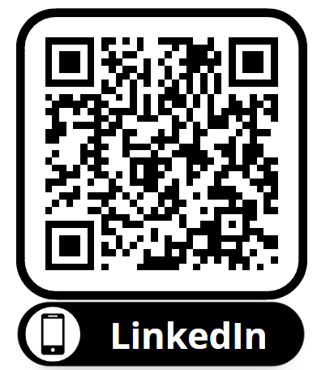
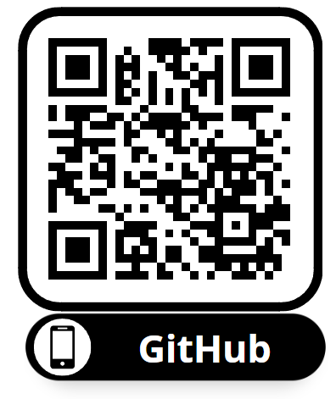
Thank you! Questions?
Leticia Santos

